Slide 1
Lesson 5.1b Part 2 Adding and Subtracting Rational Expressions
© Copyright all rights reserved to Homework depot: www.BCMath.ca

Slide 2
Common Denominators
When adding or subtracting rational expressions, they must have a common denominator
The “Common Denominators” must contain all the denominators of every term
If a denominator has a binomial, it must contain the entire binomial
You can’t just “subtract in” or “add in” the missing term
EX: Find the Lowest Common Denominator

Slide 3
Ex: Find the Lowest Common Denominator:

Slide 4
II) Adding/Subtracting Rational Expr.
If the denominator has a binomial, you need to multiply in the binomial to the terms that don’t it
NOTE: You can’t just “subtract in” or “add in” the missing term
The Common Denominator must have
The 1st fraction is missing x-3 , so multiply both top/bottom by x-3
The 2nd fraction is missing x , so multiply both top/bottom by x
Now they have a C.D., combine the fractions and like-terms
NOTE: Don’t multiply the denominators!!!

Slide 5
Practice: Find the LCD and then Simplify by adding/subtracting

Slide 6
LCD
LCD

Slide 7
LCD
LCD
© Copyright all rights reserved to Homework depot: www.BCMath.ca

Slide 8
Factor the Denominators!!
If the denominator is a trinomial or a difference of squares, “ALWAYS” factor them first!!
After factoring, look for any missing terms or binomials!
Then multiply those missing terms in to get the LCD
The denominator in the 1st fraction can be factored!! (Difference of squares)
Now we see that the common denominator just needs “x+4” and “x-4”
LCD: (x+4)(x-4)
The 1st fraction doesn’t need to multiply in any terms
The 2nd fraction needs to multiply in (x-4)

Slide 9
Practice: Find the LCD and then simplify by Adding or Subtracting the expressions. Find all the NPV’s
NPV:

Slide 10
Ex: Factor , simplify, and state all NPV’s
© Copyright all rights reserved to Homework depot: www.BCMath.ca

Slide 11
There’s a trick to this question:
Therefore, the 2nd fraction can be changed to:
So the original expression becomes:
© Copyright all rights reserved to Homework depot: www.BCMath.ca

Slide 12
IV) Simplifying R.E. with Fractions
When Simplifying R.E. with Fractions, multiply ALL terms with the LCD to cancel out any denominators
Find the denominator in each fraction:
Denominator:
Find the LCD:
Find the LCD:
Multiply all terms by LCD
Multiply all terms by LCD to cancel out the Denominator
(Distribution/Expand)

Slide 13
Practice: Simplify each of the following

Slide 14
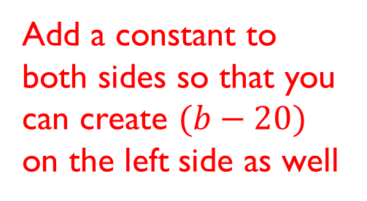
Simon’s Factoring Method:
Simon’s Factoring Method is a process for finding all the possible combinations of “a”, “b”, “c” such that the equation above is true
Usually, one of “a”, “b”, or “c” is given, goal is to turn the equation into factored form:
Move one term over to the other side:
Add a constant to both sides so that you can create $(b−20)$ on the left side as well
With the equation in factored form, find all pairs of integers that multiply to 400

Slide 15
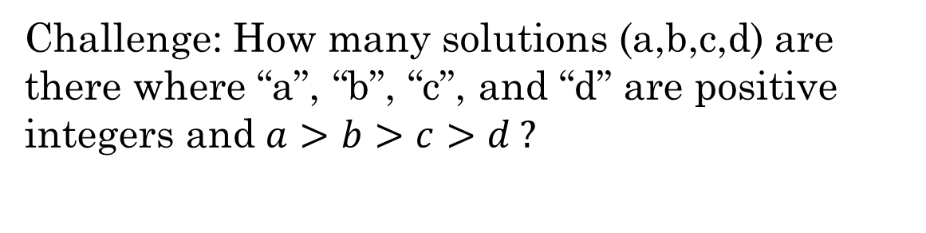
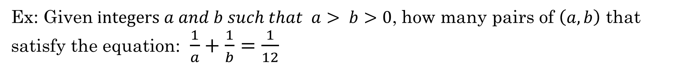
Ex: Given$integers a and b such that a> b>0$, how many pairs of $\left(a, b\right)$ that satisfy the equation: $\frac{1}{a}+\frac{1}{b}=\frac{1}{12}$
ii) What is the maximum value of “a”?
Challenge: How many solutions (a,b,c,d) are there where “a”, “b”, “c”, and “d” are positive integers and $a>b>c>d ?$

